Slide 1
Collision Dynamics (Soft Particle Impact)
Presented By
Sourit Saha
Summer Intern
IIT Mandi

Slide 2
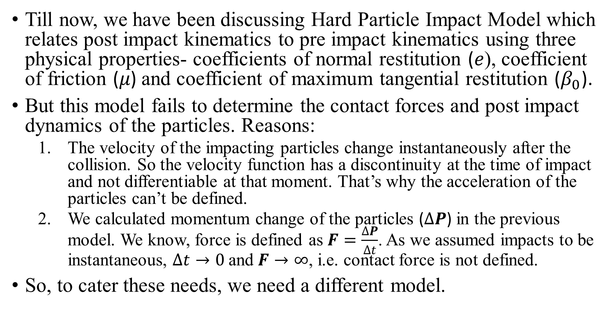
Why Soft Particle Impact Model?
Till now, we have been discussing Hard Particle Impact Model which relates post impact kinematics to pre impact kinematics using three physical properties- coefficients of normal restitution (𝑒), coefficient of friction (𝜇) and coefficient of maximum tangential restitution ($β_{0}$).
But this model fails to determine the contact forces and post impact dynamics of the particles. Reasons:
The velocity of the impacting particles change instantaneously after the collision. So the velocity function has a discontinuity at the time of impact and not differentiable at that moment. That’s why the acceleration of the particles can’t be defined.
We calculated momentum change of the particles ($∆P$) in the previous model. We know, force is defined as $F=\frac{∆P}{∆t}$. As we assumed impacts to be instantaneous, $∆t→0$ and $F→∞$, i.e. contact force is not defined.
So, to cater these needs, we need a different model.

Slide 3
Elastic Interaction
The application of external strain fields to granular materials causes relative movement between the constitutive particles.
As a result of the relative displacements between contiguous particles, forces are generated at the interparticle contacts and the macroscopic state of stress is a function of the distribution of contact forces within the material.
The contact force-displacement behaviour depends on the material properties of the particles, the sizes of the two particles in contact and the surface conditions.
The normal and tangential force-displacement relationships for elastic spheres with friction are provided by the theories of Hertz (1881), Mindlin (1949), and Mindlin and Deresiewicz (1953).
The normal and tangential contact forces are obtained by integrating the respective normal and tangential traction distributions over the contact area.

Slide 4
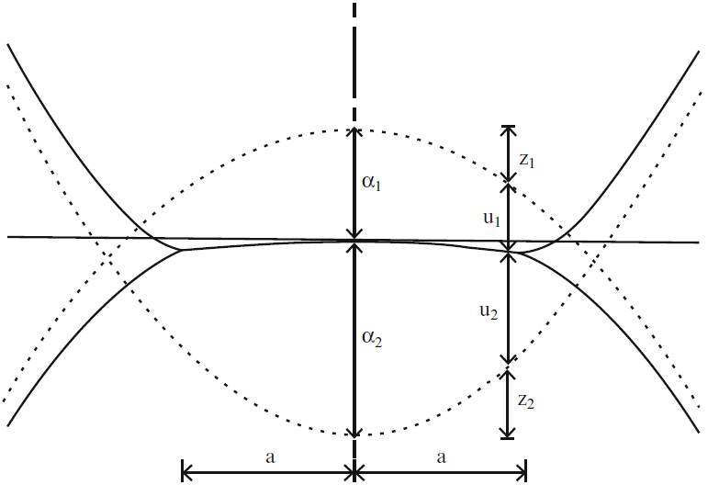
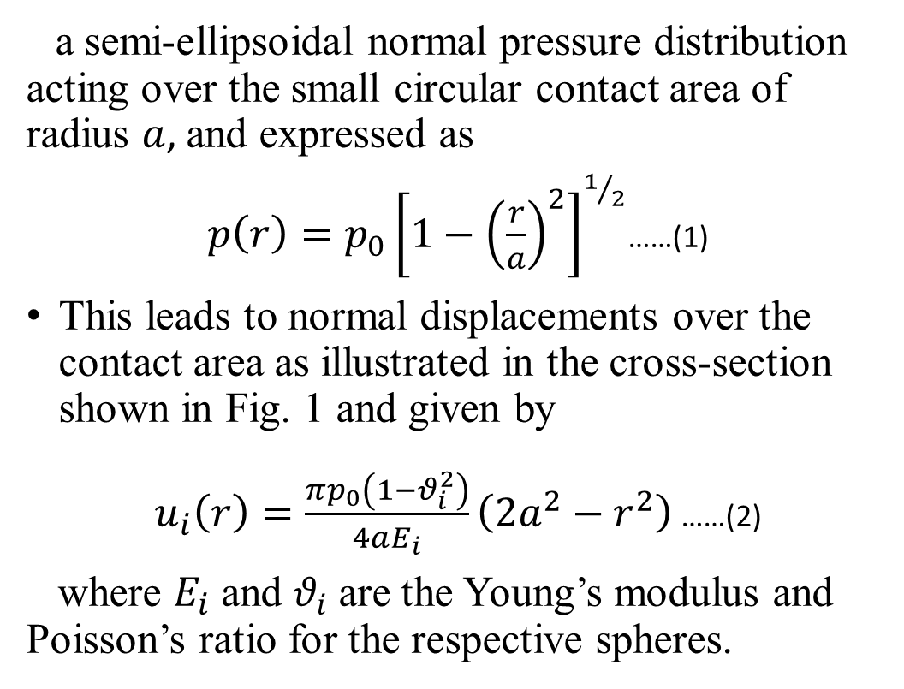
Normal Interaction
For two contacting elastic spheres of radii $R_{i} (i=1,2)$, the theory of Hertz (1881) predicts
a semi-ellipsoidal normal pressure distribution acting over the small circular contact area of radius $a$, and expressed as
$p\left(r\right)=p_{0}{\left[1−{\left(\frac{r}{a}\right)}^{2}\right]}^{1/2}$……(1)
This leads to normal displacements over the contact area as illustrated in the cross-section shown in Fig. 1 and given by
$u_{i}\left(r\right)=\frac{πp_{0}\left(1−θ_{i}^{2}\right)}{4aE_{i}}\left(2a^{2}−r^{2}\right)$ ……(2)
where $E_{i}$ and $θ_{i}$ are the Young’s modulus and Poisson’s ratio for the respective spheres.
Fig. 1. Geometry of the local deformation at the contact between two dissimilar, unequal sized
elastic spheres subjected to an applied normal force

Slide 5
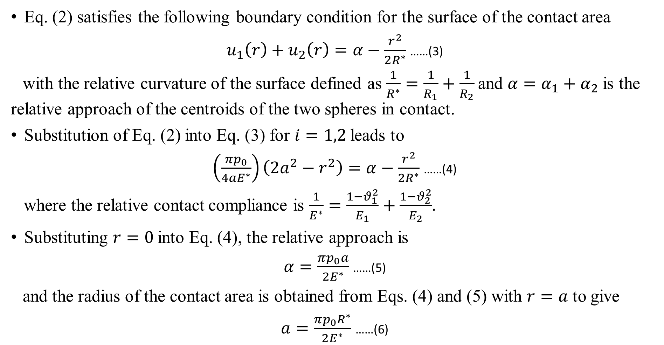
Normal Interaction (contd…)
Eq. (2) satisfies the following boundary condition for the surface of the contact area
$u_{1}\left(r\right)+u_{2}\left(r\right)=α−\frac{r^{2}}{2R^{∗}}$ ……(3)
with the relative curvature of the surface defined as $\frac{1}{R^{∗}}=\frac{1}{R_{1}}+\frac{1}{R_{2}}$ and $α=α_{1}+α_{2}$ is the relative approach of the centroids of the two spheres in contact.
Substitution of Eq. (2) into Eq. (3) for $i=1,2$leads to
$\left(\frac{πp_{0}}{4aE^{∗}}\right)\left(2a^{2}−r^{2}\right)=α−\frac{r^{2}}{2R^{∗}}$ ……(4)
where the relative contact compliance is $\frac{1}{E^{∗}}=\frac{1−θ_{1}^{2}}{E_{1}}+\frac{1−θ_{2}^{2}}{E_{2}}$.
Substituting $r=0$ into Eq. (4), the relative approach is
$α=\frac{πp_{0}a}{2E^{∗}}$ ……(5)
and the radius of the contact area is obtained from Eqs. (4) and (5) with $r=a$ to give
$a=\frac{πp_{0}R^{∗}}{2E^{∗}}$ ……(6)

Slide 6
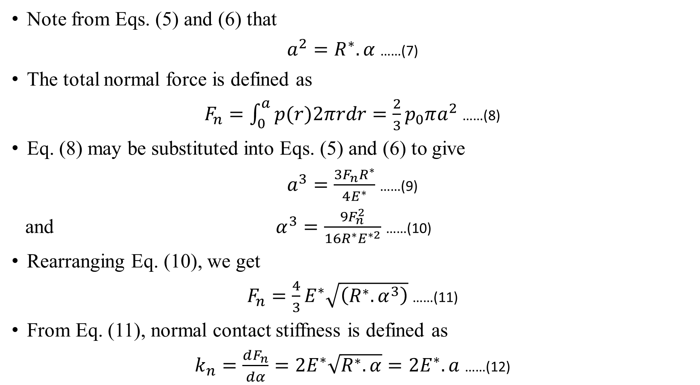
Normal Interaction (contd…)
Note from Eqs. (5) and (6) that
$a^{2}=R^{∗}.α$ ……(7)
The total normal force is defined as
$F_{n}=\int_{0}^{a}{p(r)2πrdr}=\frac{2}{3}p_{0}πa^{2}$ ……(8)
Eq. (8) may be substituted into Eqs. (5) and (6) to give
$a^{3}=\frac{3F_{n}R^{∗}}{4E^{∗}}$ ……(9)
and $α^{3}=\frac{9F_{n}^{2}}{16R^{∗}E^{∗2}}$ ……(10)
Rearranging Eq. (10), we get
$F_{n}=\frac{4}{3}E^{∗}\sqrt{\left(R^{∗}.α^{3}\right)}$ ……(11)
From Eq. (11), normal contact stiffness is defined as
$k_{n}=\frac{dF_{n}}{dα}=2E^{∗}\sqrt{R^{∗}.α}=2E^{∗}.a$ ……(12)

Slide 7
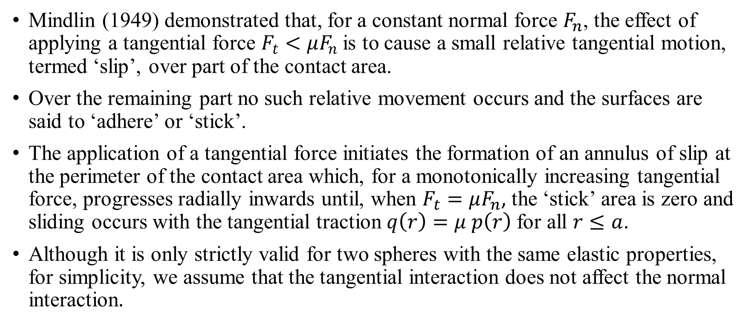
Tangential Interaction
Mindlin (1949) demonstrated that, for a constant normal force $F_{n}$, the effect of applying a tangential force $F_{t}<μF_{n}$ is to cause a small relative tangential motion, termed ‘slip’, over part of the contact area.
Over the remaining part no such relative movement occurs and the surfaces are said to ‘adhere’ or ‘stick’.
The application of a tangential force initiates the formation of an annulus of slip at the perimeter of the contact area which, for a monotonically increasing tangential force, progresses radially inwards until, when $F_{t}=μF_{n}$, the ‘stick’ area is zero and sliding occurs with the tangential traction $q\left(r\right)=μ p\left(r\right)$ for all $r≤a$.
Although it is only strictly valid for two spheres with the same elastic properties, for simplicity, we assume that the tangential interaction does not affect the normal interaction.

Slide 8
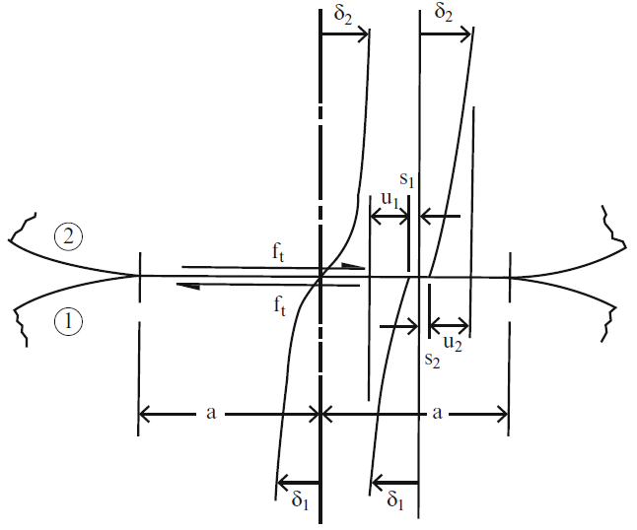
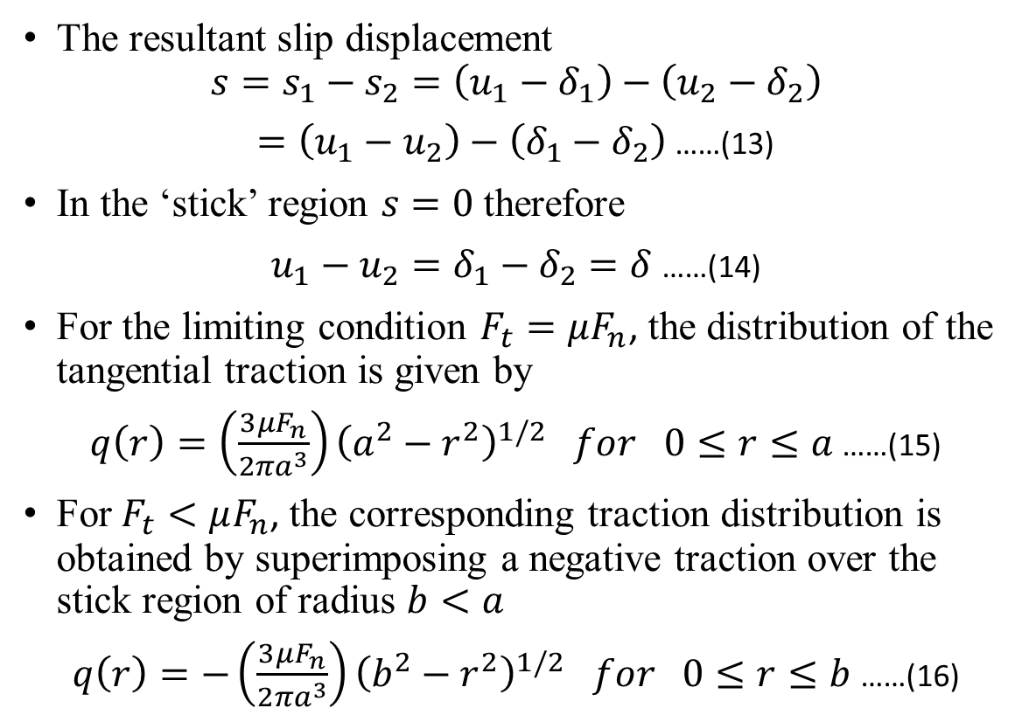
The tangential force results in shear deformation adjacent to the contact surface as illustrated in Fig. 2, which shows the rigid displacements of the sphere centres $δ_{i}$, the tangential elastic displacements at the contact surface $u_{i}$ and the slip displacements $s_{i}$.
Tangential Interaction (contd…)
The resultant slip displacement
$$s=s_{1}−s_{2}=\left(u_{1}−δ_{1}\right)−\left(u_{2}−δ_{2}\right)$$
$=\left(u_{1}−u_{2}\right)−\left(δ_{1}−δ_{2}\right)$ ……(13)
In the ‘stick’ region $s=0$ therefore
$u_{1}−u_{2}=δ_{1}−δ_{2}=δ$ ……(14)
For the limiting condition $F_{t}=μF_{n}$, the distribution of the tangential traction is given by
$q\left(r\right)=\left(\frac{3μF_{n}}{2πa^{3}}\right){\left(a^{2}−r^{2}\right)}^{1/2} for 0≤r≤a$ ……(15)
For $F_{t}<μF_{n}$, the corresponding traction distribution is obtained by superimposing a negative traction over the stick region of radius $b<a$
$q\left(r\right)=−\left(\frac{3μF_{n}}{2πa^{3}}\right){\left(b^{2}−r^{2}\right)}^{1/2} for 0≤r≤b$ ……(16)
Fig. 2 Shear deformation adjacent to the contact due to an applied tangential force

Slide 9
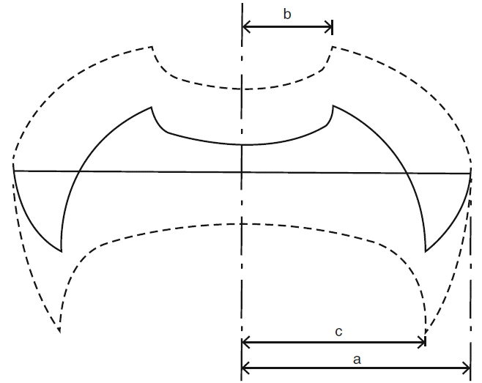
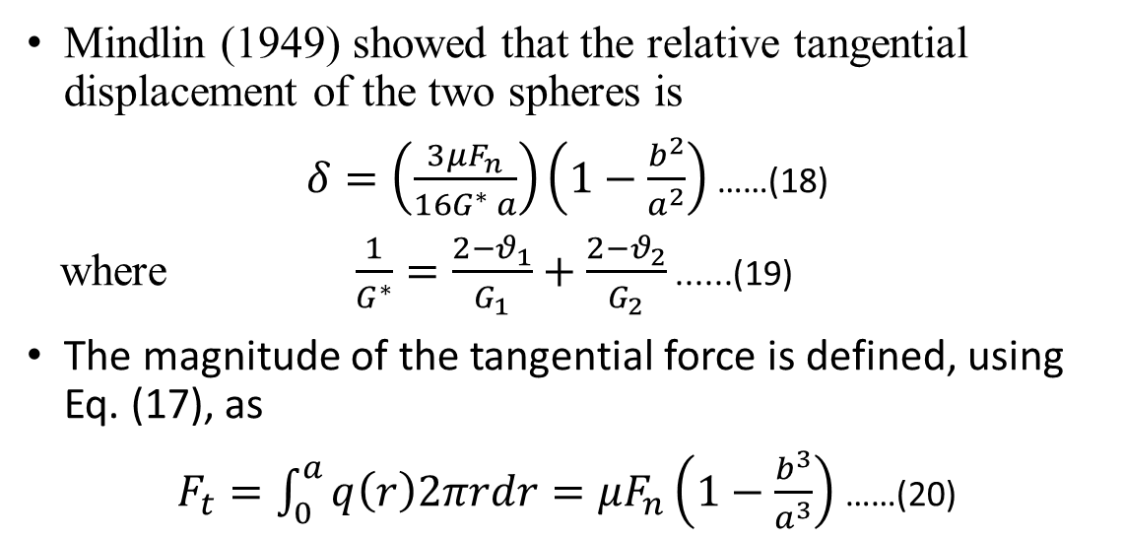
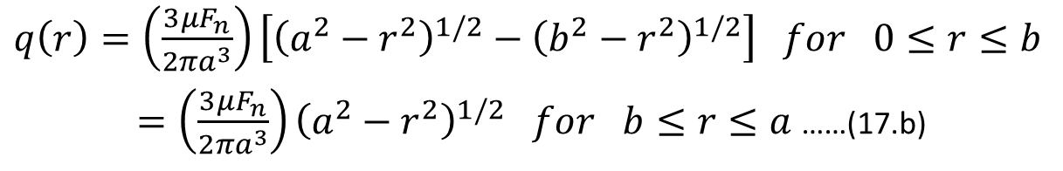
Tangential Interaction (contd…)
Hence, from Eqs. (15) and (16), the distribution of the tangential traction over the total contact area, shown in Fig. 3, is given as
$q\left(r\right)=\left(\frac{3μF_{n}}{2πa^{3}}\right)\left[{\left(a^{2}−r^{2}\right)}^{1/2}−{\left(b^{2}−r^{2}\right)}^{1/2}\right] for 0≤r≤b$
$=\left(\frac{3μF_{n}}{2πa^{3}}\right){\left(a^{2}−r^{2}\right)}^{1/2} for b≤r≤a$ ……(17.b)
……(17.a)
Mindlin (1949) showed that the relative tangential displacement of the two spheres is
$δ=\left(\frac{3μF_{n}}{16G^{∗} a}\right)\left(1−\frac{b^{2}}{a^{2}}\right)$ ……(18)
where $\frac{1}{G^{∗}}=\frac{2−θ_{1}}{G_{1}}+\frac{2−θ_{2}}{G_{2}}$ ......(19)
The magnitude of the tangential force is defined, using Eq. (17), as
$F_{t}=\int_{0}^{a}{q\left(r\right)2πrdr}=μF_{n}\left(1−\frac{b^{3}}{a^{3}}\right)$ ……(20)
Fig. 3 Tangential traction distributions during loading and during unloading

Slide 10
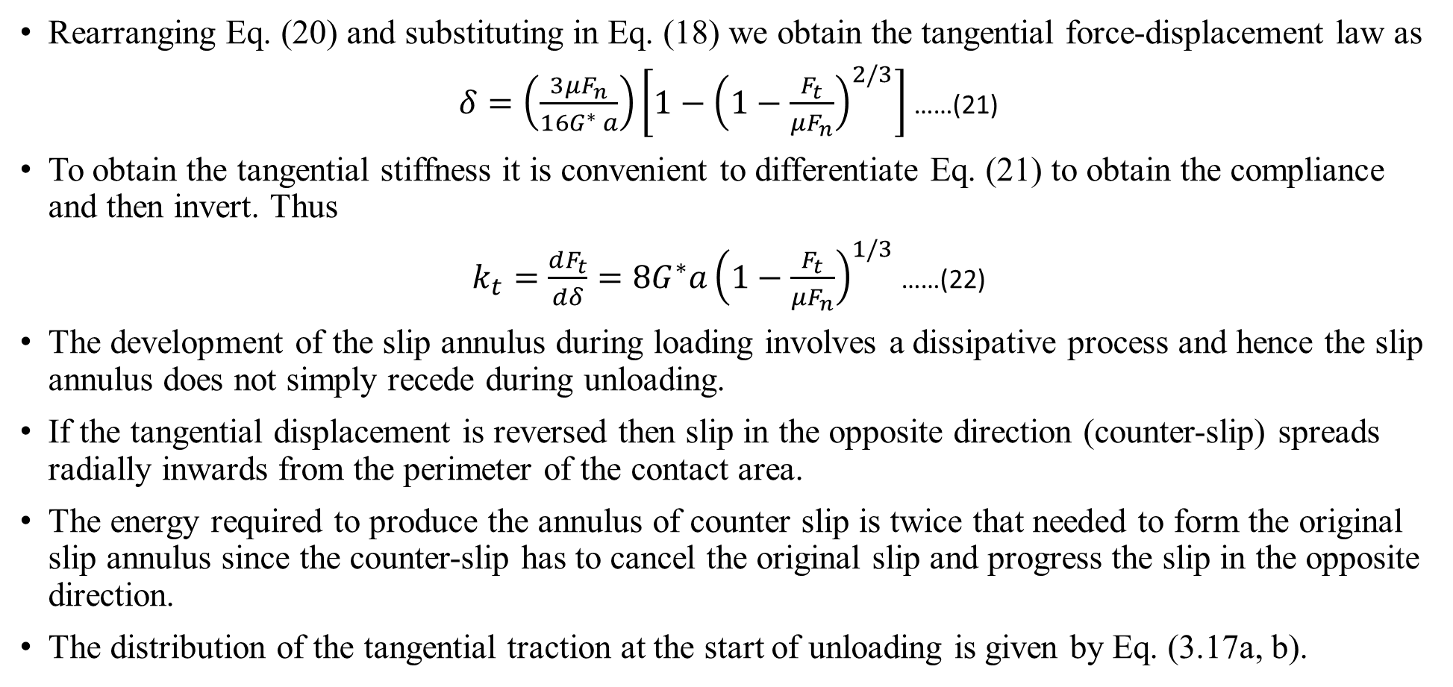
Tangential Interaction (contd…)
Rearranging Eq. (20) and substituting in Eq. (18) we obtain the tangential force-displacement law as
$δ=\left(\frac{3μF_{n}}{16G^{∗} a}\right)\left[1−{\left(1−\frac{F_{t}}{μF_{n}}\right)}^{2/3}\right]$ ……(21)
To obtain the tangential stiffness it is convenient to differentiate Eq. (21) to obtain the compliance and then invert. Thus
$k_{t}=\frac{dF_{t}}{dδ}=8G^{∗}a{\left(1−\frac{F_{t}}{μF_{n}}\right)}^{1/3}$ ……(22)
The development of the slip annulus during loading involves a dissipative process and hence the slip annulus does not simply recede during unloading.
If the tangential displacement is reversed then slip in the opposite direction (counter-slip) spreads radially inwards from the perimeter of the contact area.
The energy required to produce the annulus of counter slip is twice that needed to form the original slip annulus since the counter-slip has to cancel the original slip and progress the slip in the opposite direction.
The distribution of the tangential traction at the start of unloading is given by Eq. (3.17a, b).

Slide 11
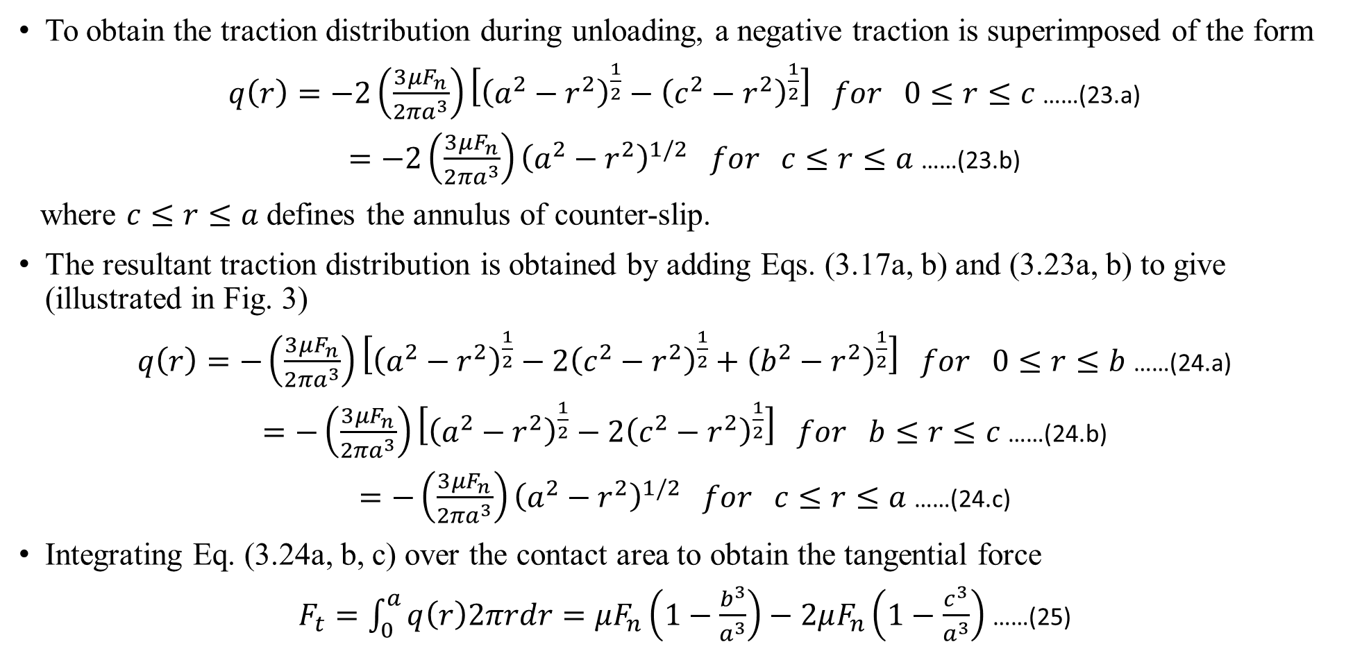
Tangential Interaction (contd…)
To obtain the traction distribution during unloading, a negative traction is superimposed of the form
$q\left(r\right)=−2\left(\frac{3μF_{n}}{2πa^{3}}\right)\left[{\left(a^{2}−r^{2}\right)}^{\frac{1}{2}}−{\left(c^{2}−r^{2}\right)}^{\frac{1}{2}}\right] for 0≤r≤c$ ……(23.a)
$=−2\left(\frac{3μF_{n}}{2πa^{3}}\right){\left(a^{2}−r^{2}\right)}^{1/2} for c≤r≤a$ ……(23.b)
where $c≤r≤a$ defines the annulus of counter-slip.
The resultant traction distribution is obtained by adding Eqs. (3.17a, b) and (3.23a, b) to give (illustrated in Fig. 3)
$q\left(r\right)=−\left(\frac{3μF_{n}}{2πa^{3}}\right)\left[{\left(a^{2}−r^{2}\right)}^{\frac{1}{2}}−2{\left(c^{2}−r^{2}\right)}^{\frac{1}{2}}+{\left(b^{2}−r^{2}\right)}^{\frac{1}{2}}\right] for 0≤r≤b$ ……(24.a)
$=−\left(\frac{3μF_{n}}{2πa^{3}}\right)\left[{\left(a^{2}−r^{2}\right)}^{\frac{1}{2}}−2{\left(c^{2}−r^{2}\right)}^{\frac{1}{2}}\right] for b≤r≤c$ ……(24.b)
$=−\left(\frac{3μF_{n}}{2πa^{3}}\right){\left(a^{2}−r^{2}\right)}^{1/2} for c≤r≤a$ ……(24.c)
Integrating Eq. (3.24a, b, c) over the contact area to obtain the tangential force
$F_{t}=\int_{0}^{a}{q\left(r\right)2πrdr}=μF_{n}\left(1−\frac{b^{3}}{a^{3}}\right)−2μF_{n}\left(1−\frac{c^{3}}{a^{3}}\right)$ ……(25)

Slide 12
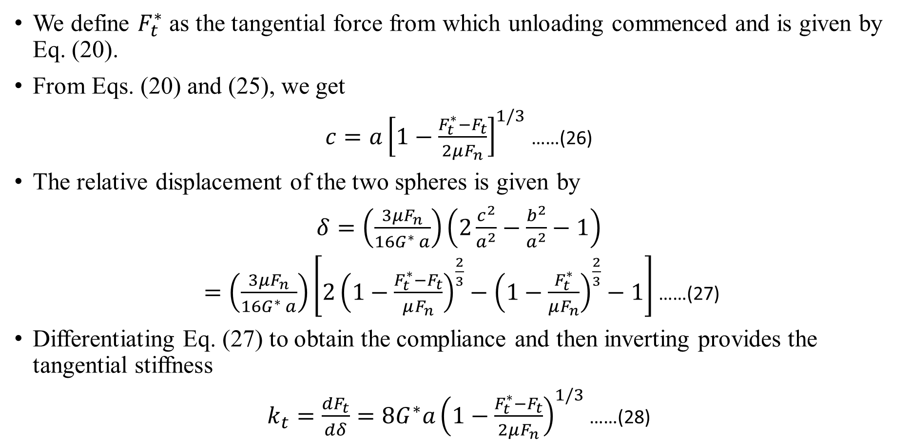
Tangential Interaction (contd…)
We define $F_{t}^{∗}$ as the tangential force from which unloading commenced and is given by Eq. (20).
From Eqs. (20) and (25), we get
$c=a{\left[1−\frac{F_{t}^{∗}−F_{t}}{2μF_{n}}\right]}^{1/3}$ ……(26)
The relative displacement of the two spheres is given by
$δ=\left(\frac{3μF_{n}}{16G^{∗} a}\right)\left(2\frac{c^{2}}{a^{2}}−\frac{b^{2}}{a^{2}}−1\right)$
$=\left(\frac{3μF_{n}}{16G^{∗} a}\right)\left[2{\left(1−\frac{F_{t}^{∗}−F_{t}}{μF_{n}}\right)}^{\frac{2}{3}}−{\left(1−\frac{F_{t}^{∗}}{μF_{n}}\right)}^{\frac{2}{3}}−1\right]$ ……(27)
Differentiating Eq. (27) to obtain the compliance and then inverting provides the tangential stiffness
$k_{t}=\frac{dF_{t}}{dδ}=8G^{∗}a{\left(1−\frac{F_{t}^{∗}−F_{t}}{2μF_{n}}\right)}^{1/3}$ ……(28)

Slide 13
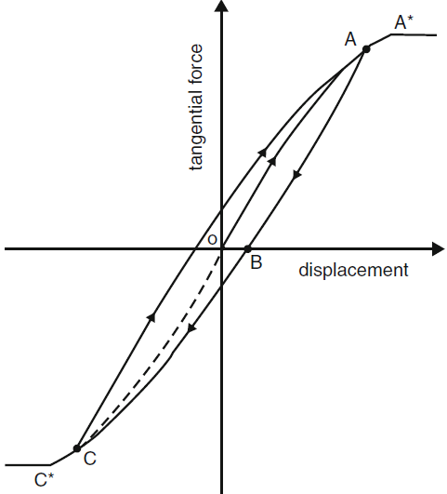
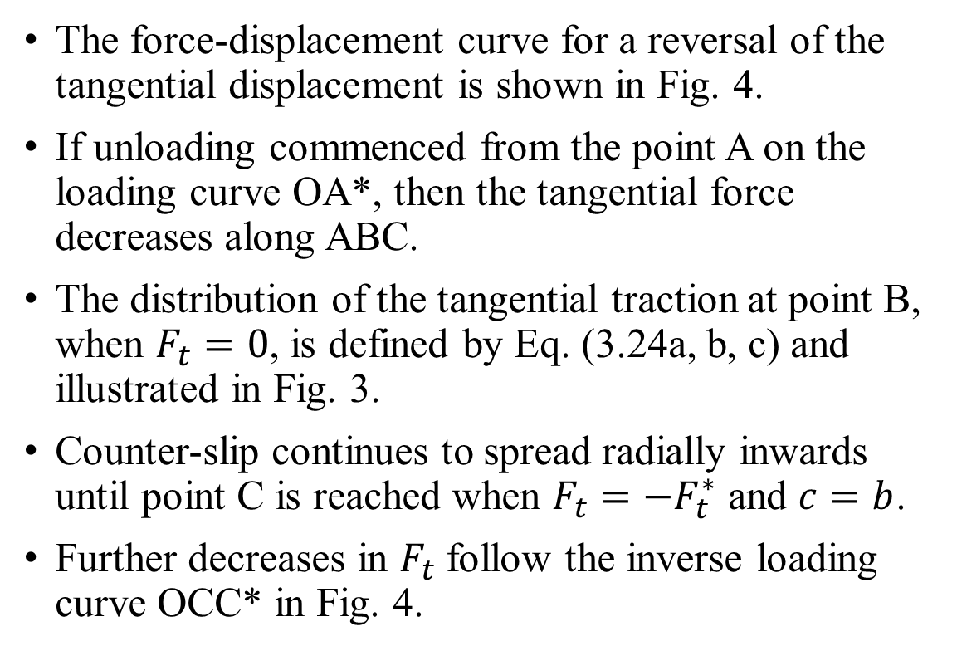
Tangential Interaction (contd…)
The force-displacement curve for a reversal of the tangential displacement is shown in Fig. 4.
If unloading commenced from the point A on the loading curve OA*, then the tangential force decreases along ABC.
The distribution of the tangential traction at point B, when $F_{t}=0$, is defined by Eq. (3.24a, b, c) and illustrated in Fig. 3.
Counter-slip continues to spread radially inwards until point C is reached when $F_{t}=−F_{t}^{∗}$ and $c=b$.
Further decreases in $F_{t}$ follow the inverse loading curve OCC* in Fig. 4.
Fig. 4 Tangential contact force-displacement relationship

Slide 14
Thank You!

